Slide 1
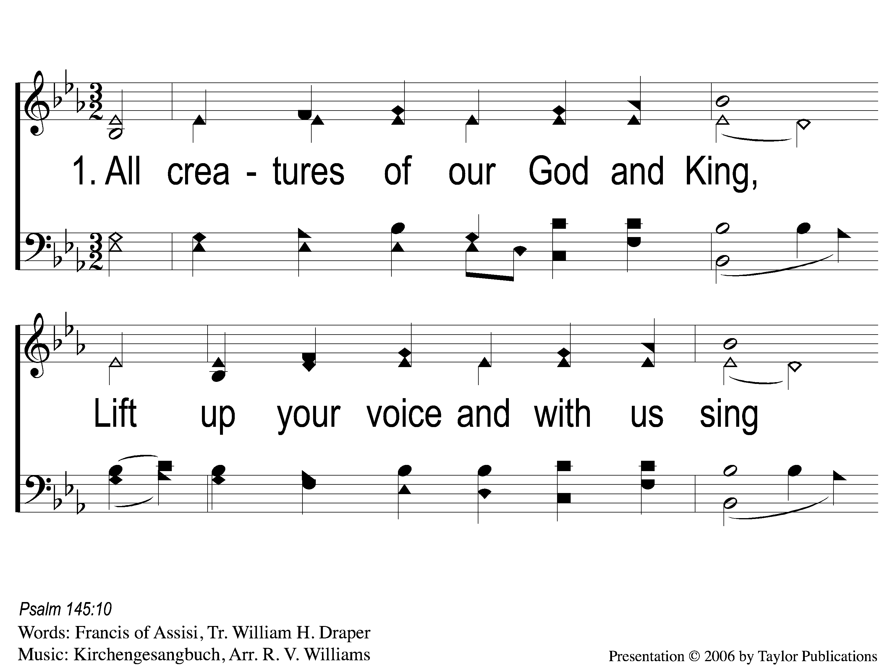
1-1 All Creatures of Our God and King
All Creatures Of Our God and King
6

Slide 2
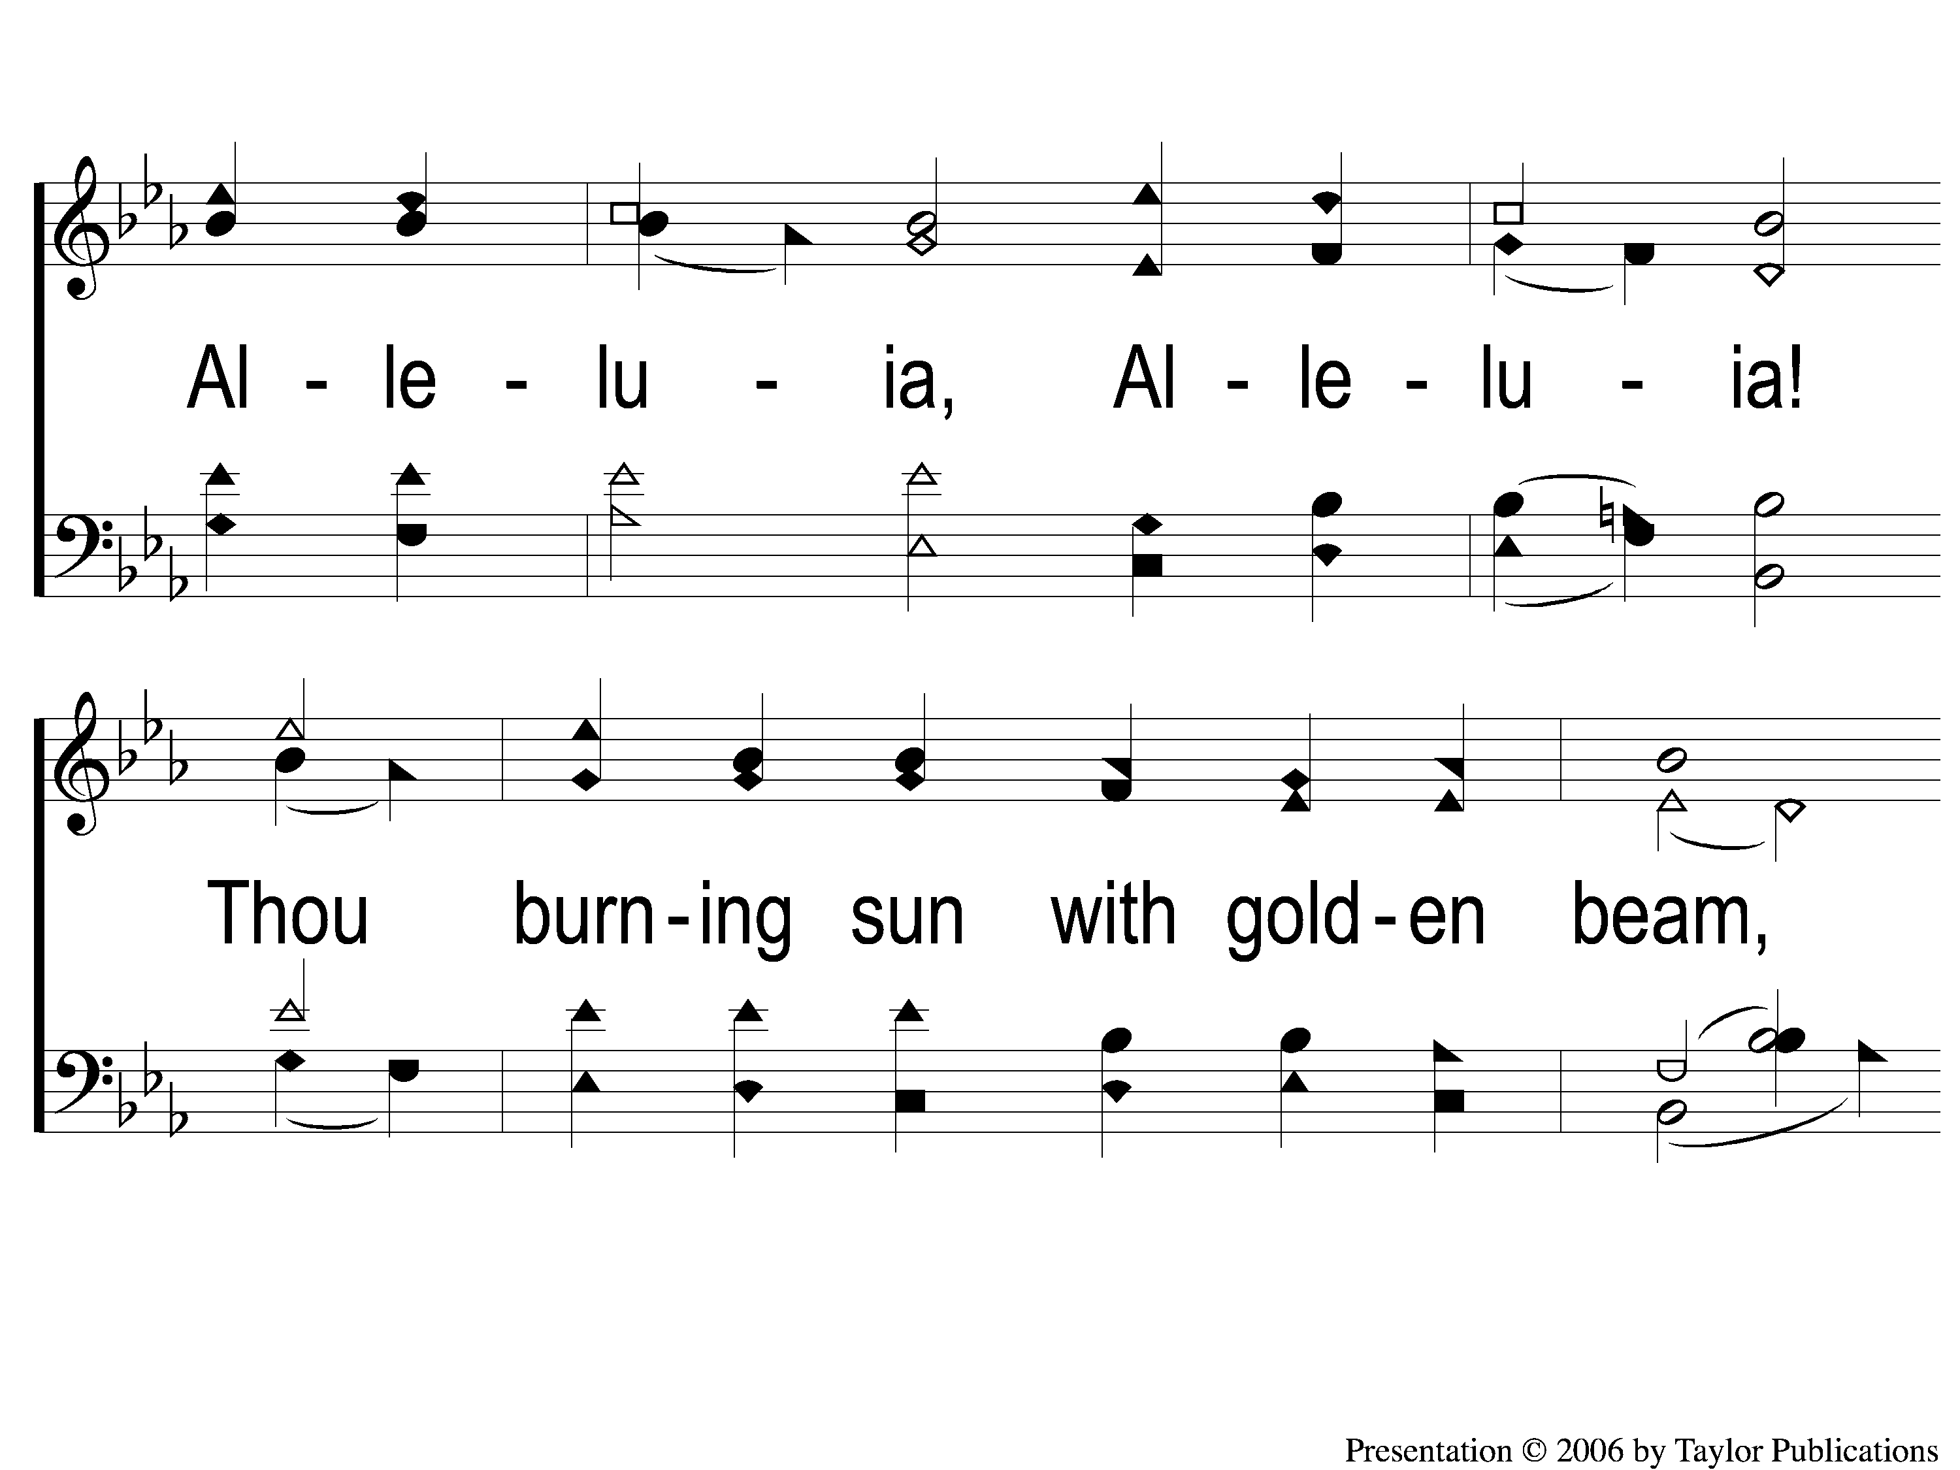
1-2 All Creatures of Our God and King
All Creatures Of Our God and King
6

Slide 3
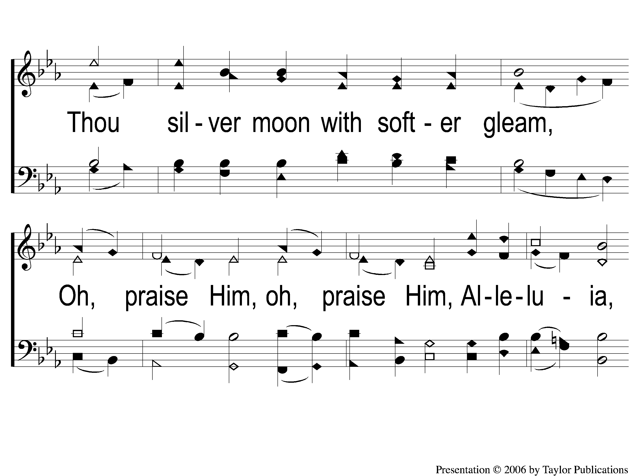
1-3 All Creatures of Our God and King
All Creatures Of Our God and King
6

Slide 4
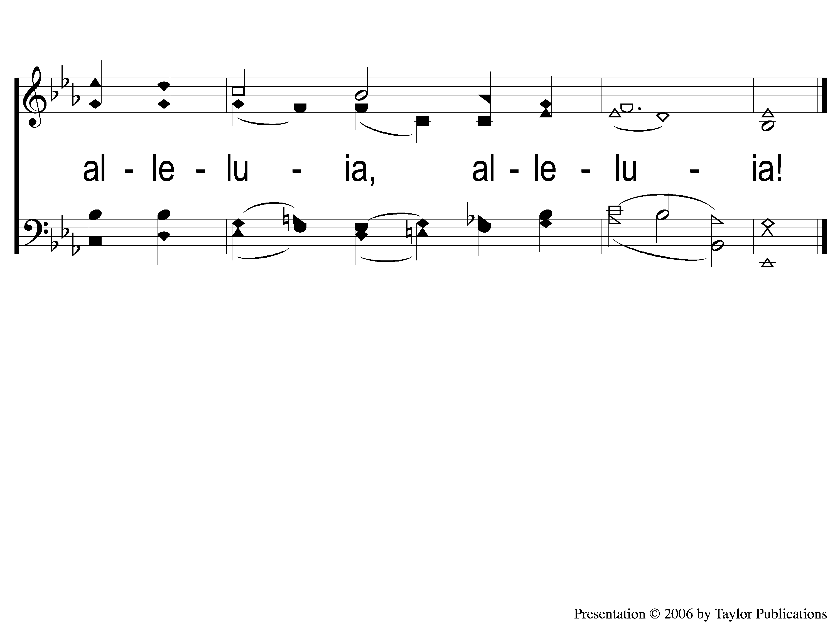
1-4 All Creatures of Our God and King
All Creatures Of Our God and King
6

Slide 5
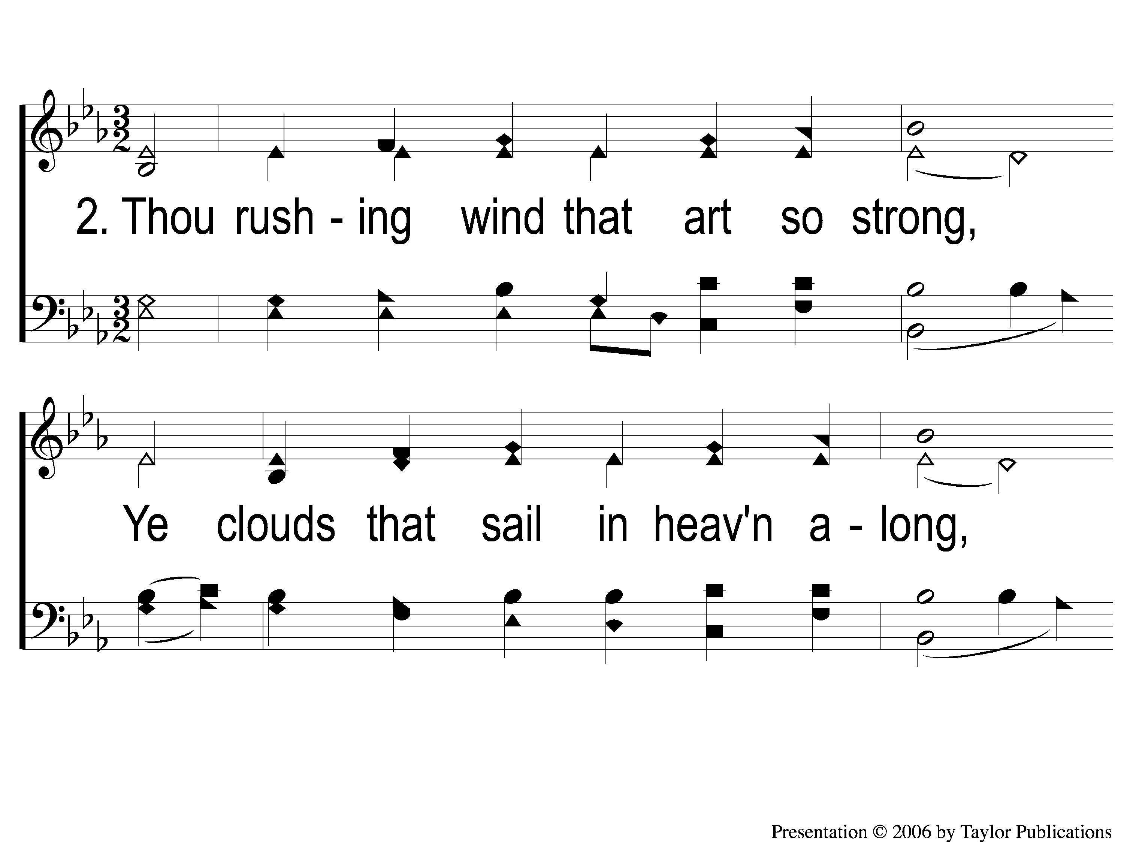
2-1 All Creatures of Our God and King
All Creatures Of Our God and King
6

Slide 6
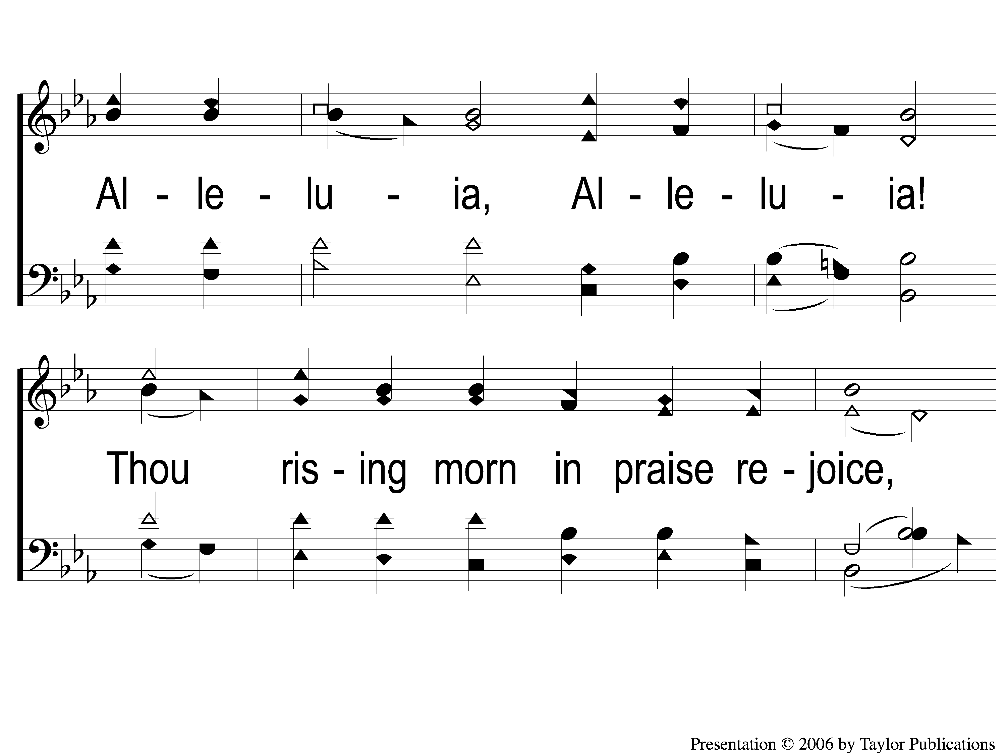
2-2 All Creatures of Our God and King
All Creatures Of Our God and King
6

Slide 7
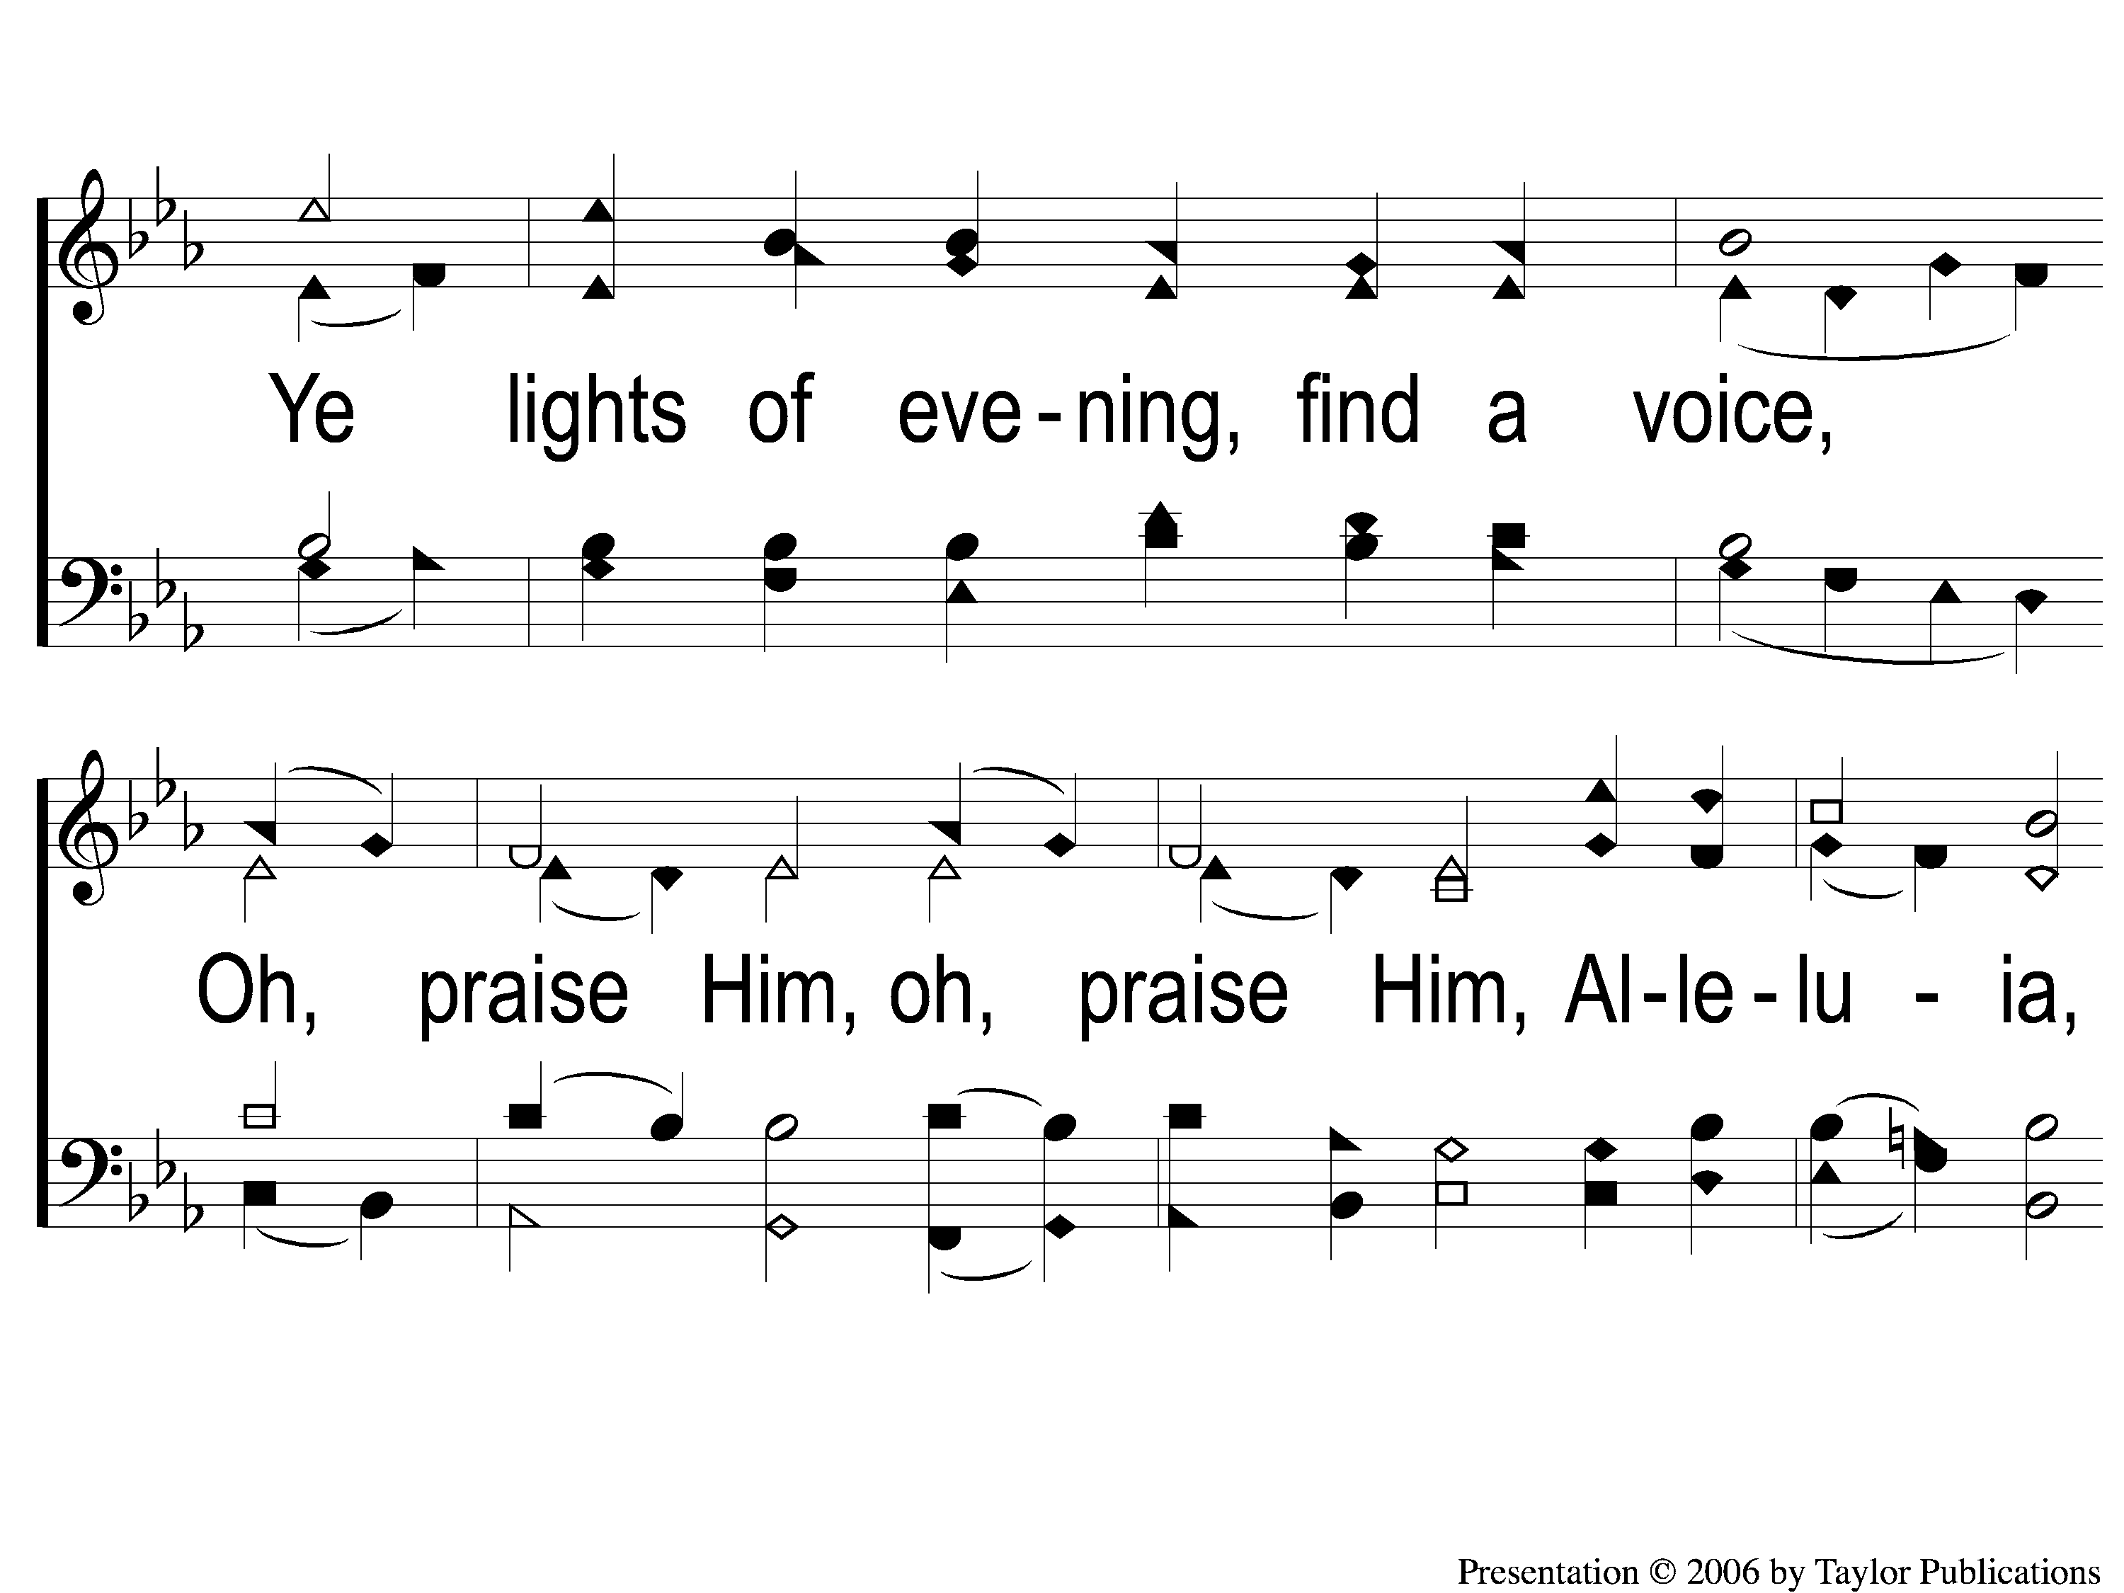
2-3 All Creatures of Our God and King
All Creatures Of Our God and King
6

Slide 8
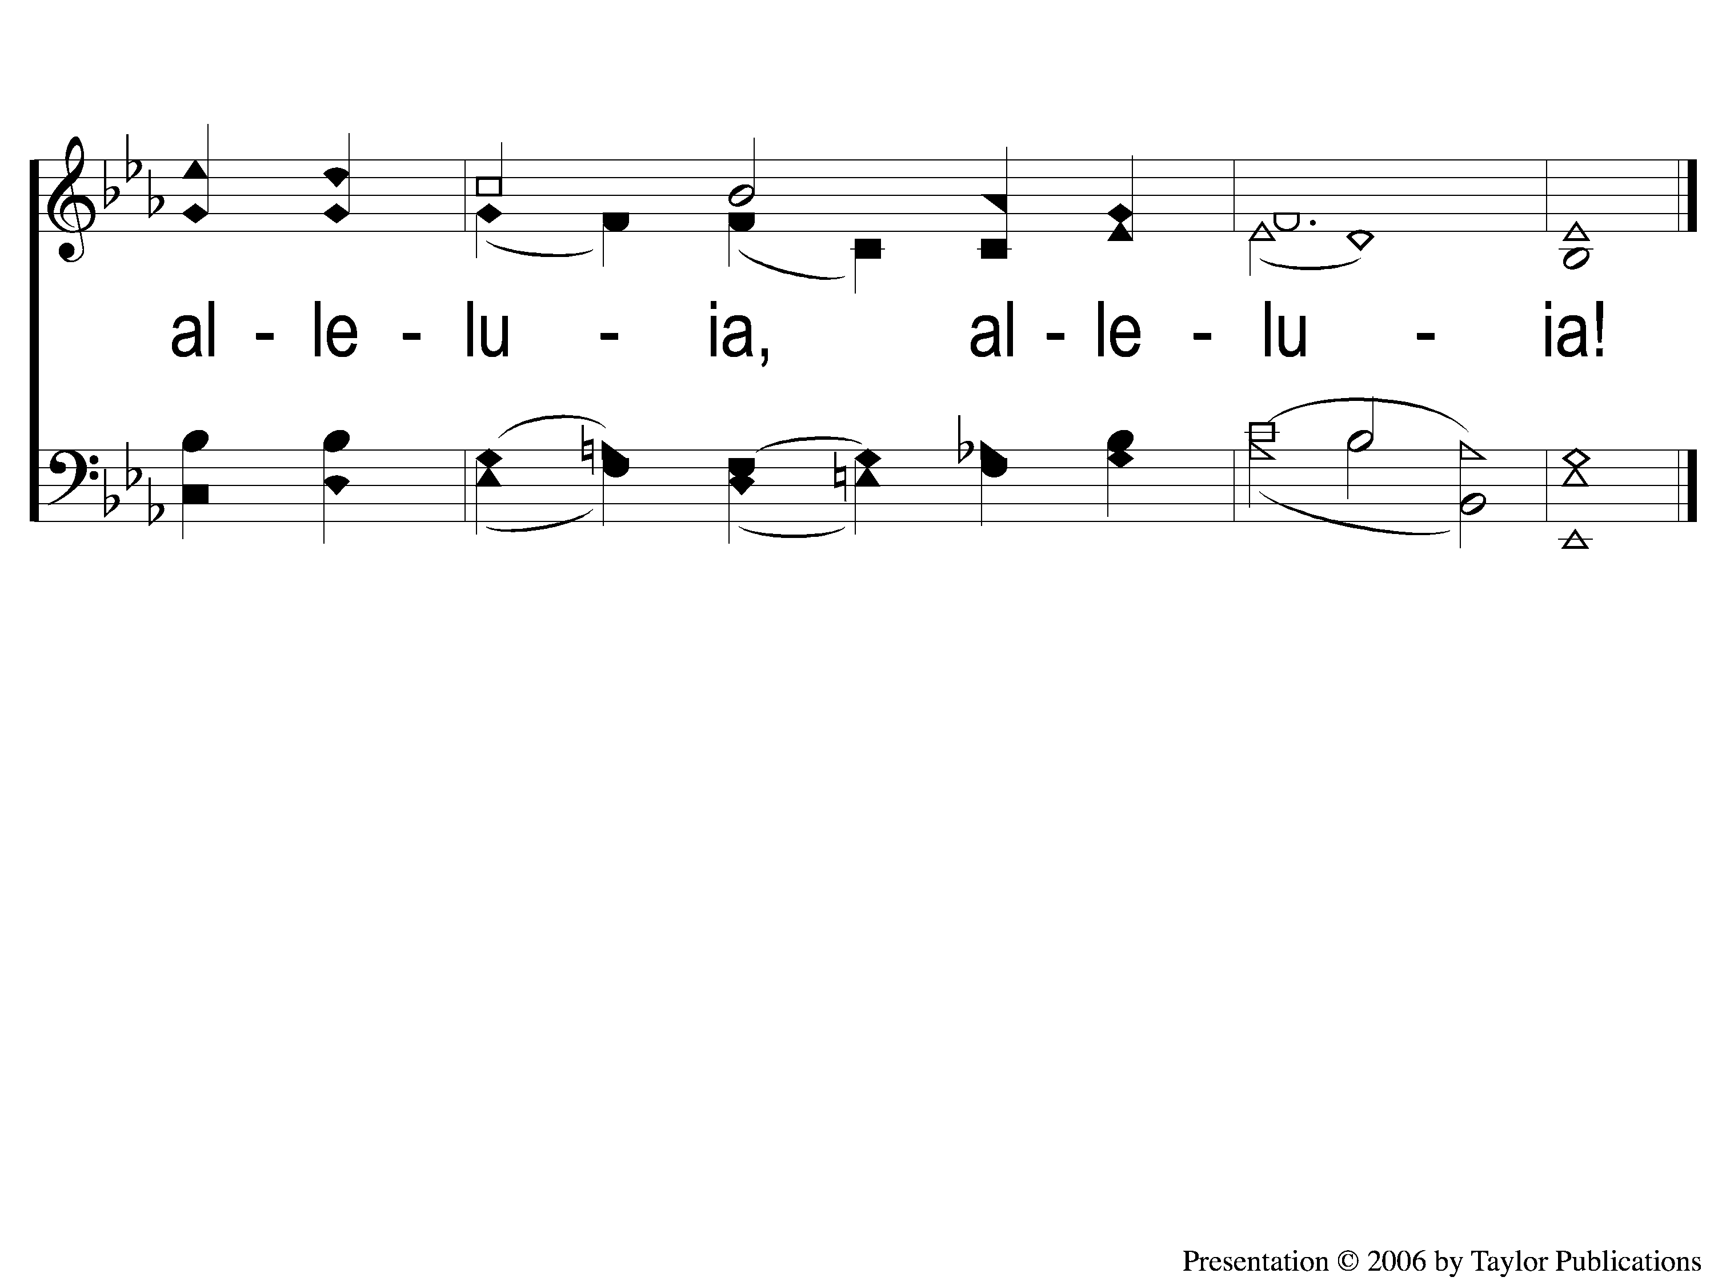
2-4 All Creatures of Our God and King
All Creatures Of Our God and King
6

Slide 9
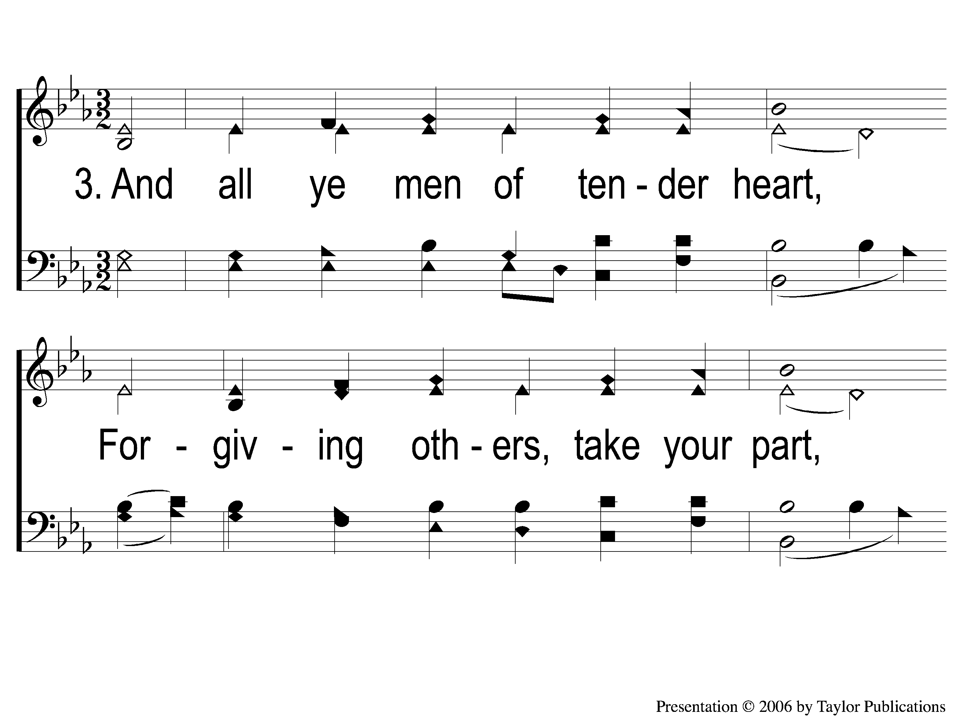
3-1 All Creatures of Our God and King
All Creatures Of Our God and King
6

Slide 10
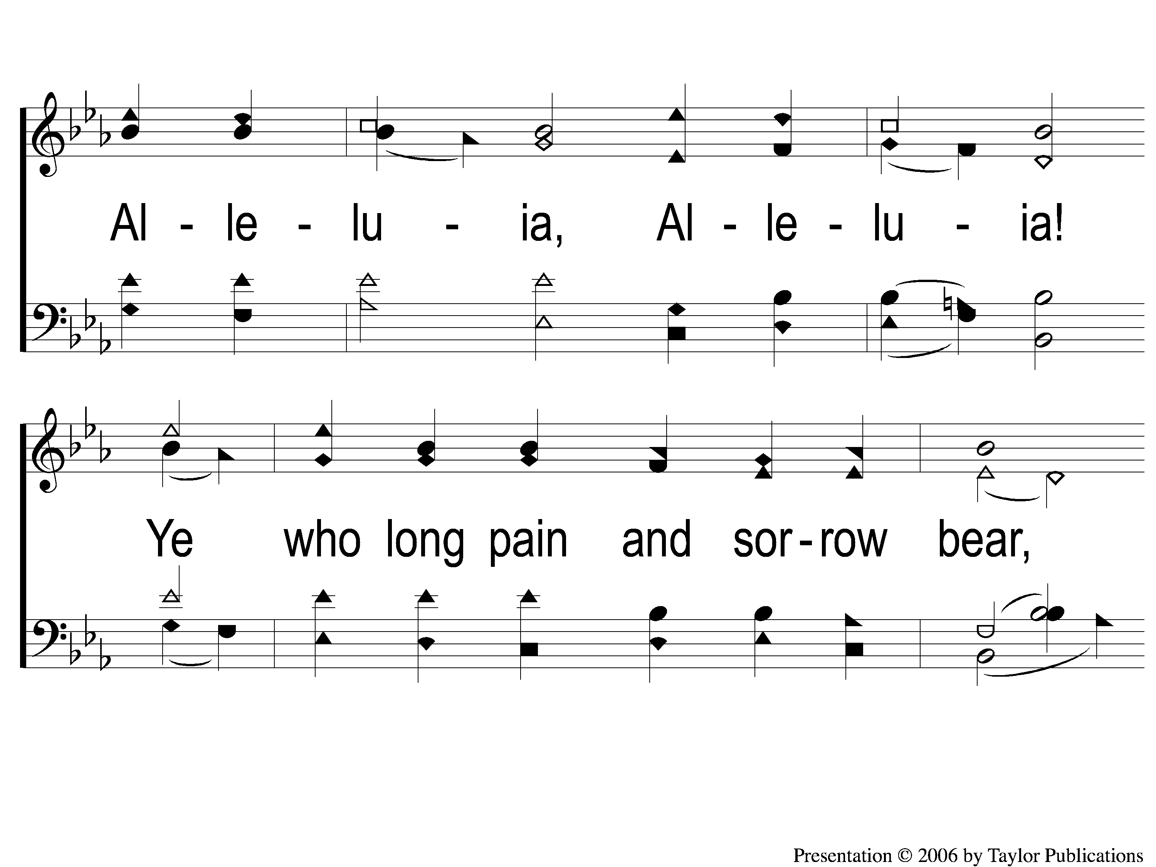
3-2 All Creatures of Our God and King
All Creatures Of Our God and King
6

Slide 11
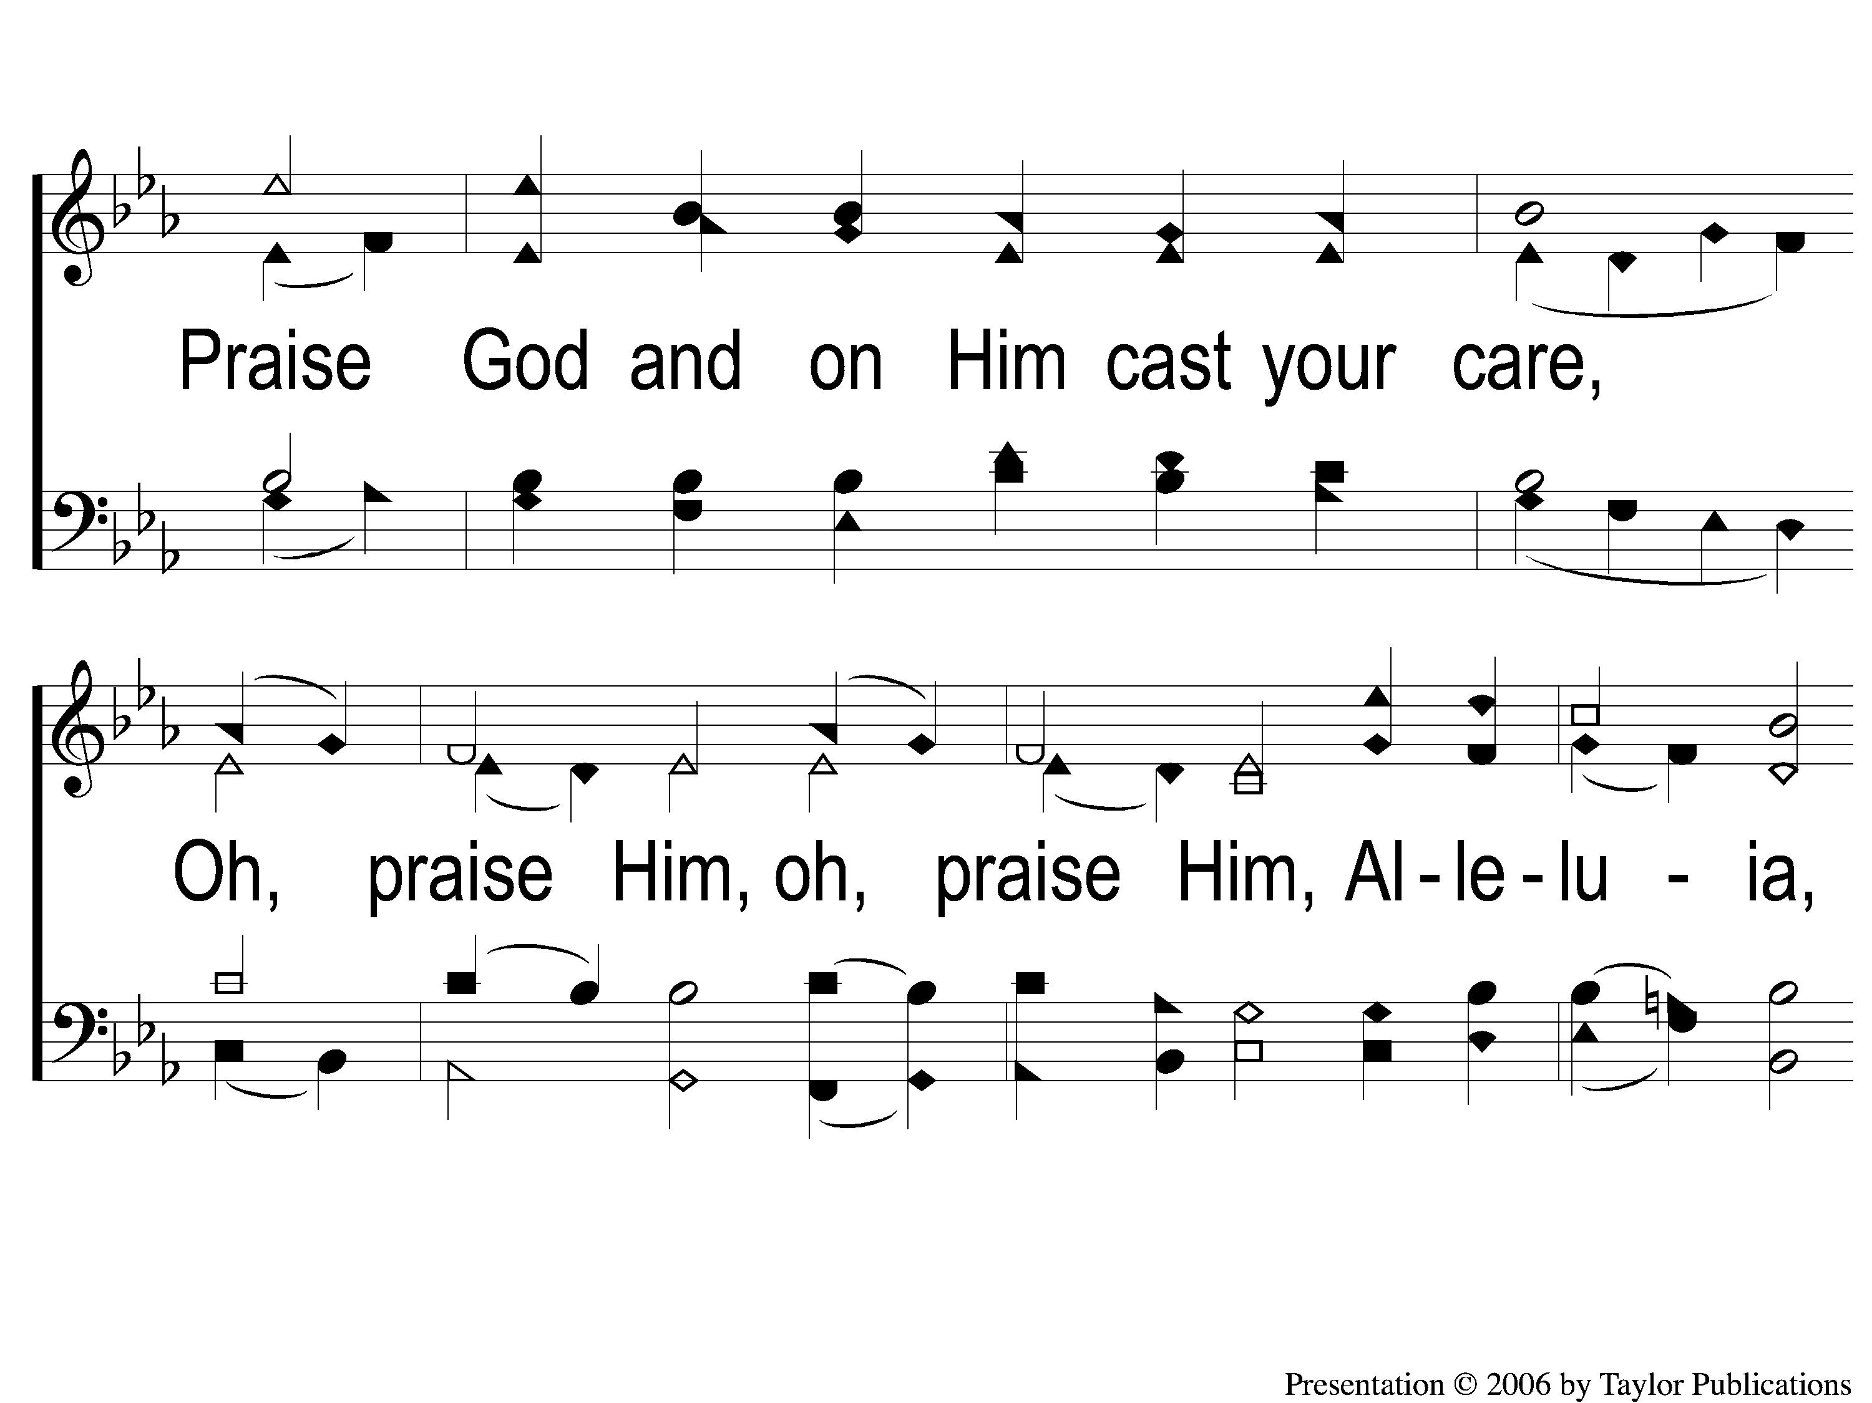
3-3 All Creatures of Our God and King
All Creatures Of Our God and King
6

Slide 12

3-4 All Creatures of Our God and King
All Creatures Of Our God and King
6

Slide 13
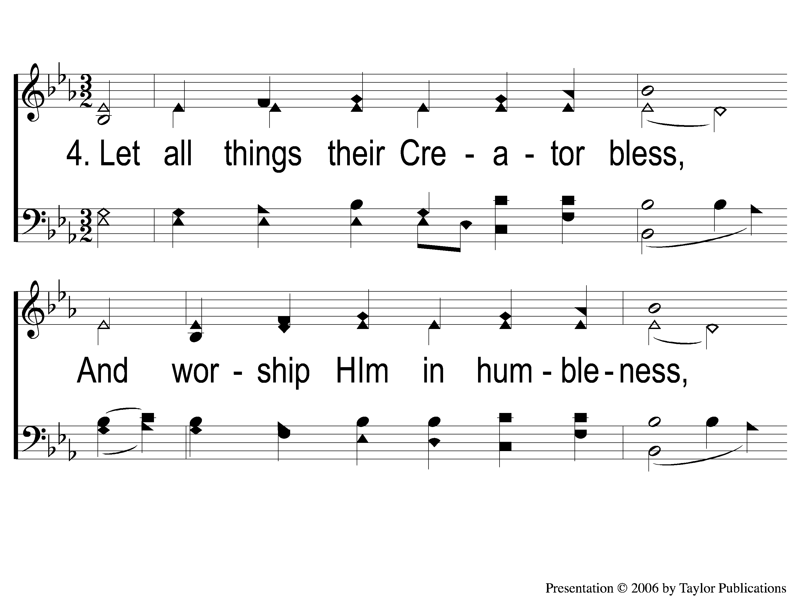
4-1 All Creatures of Our God and King
All Creatures Of Our God and King
6

Slide 14
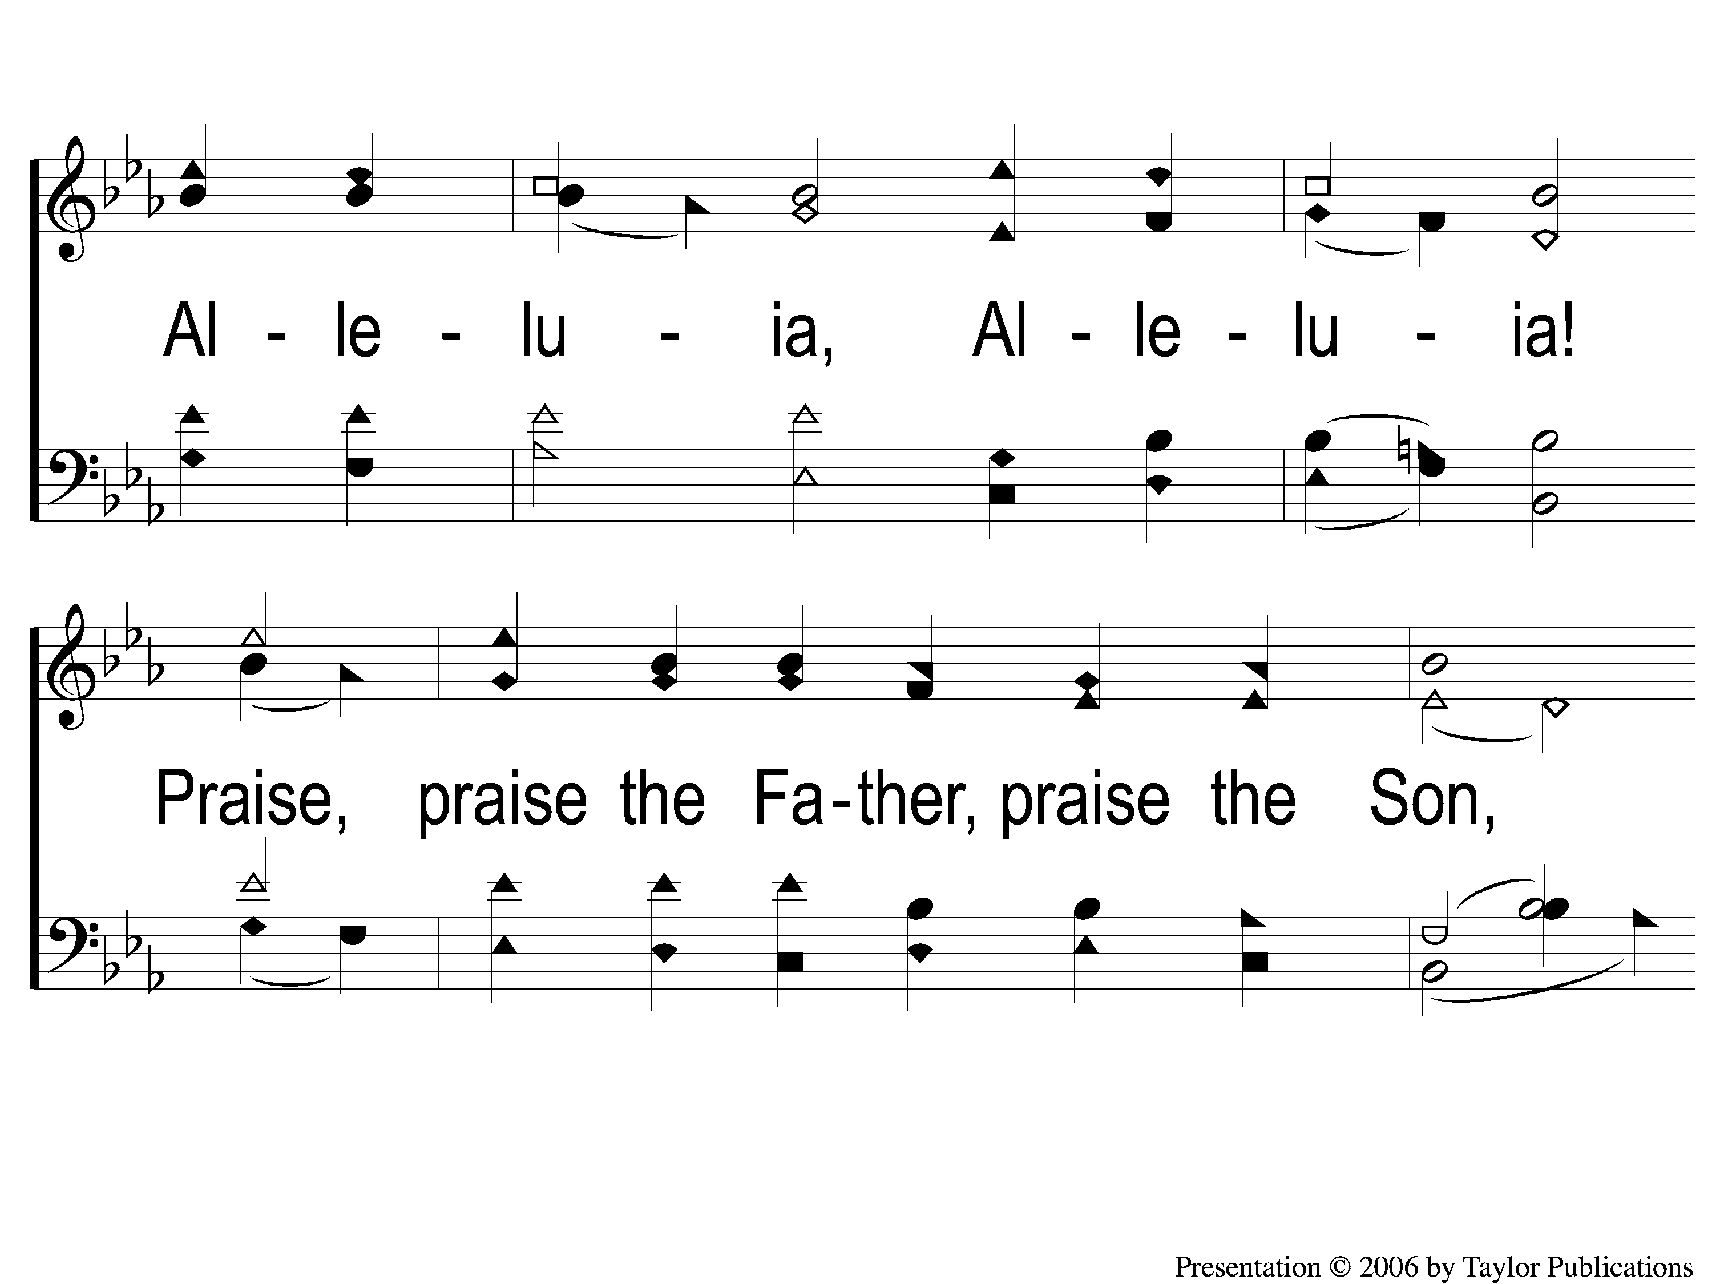
4-2 All Creatures of Our God and King
All Creatures Of Our God and King
6

Slide 15
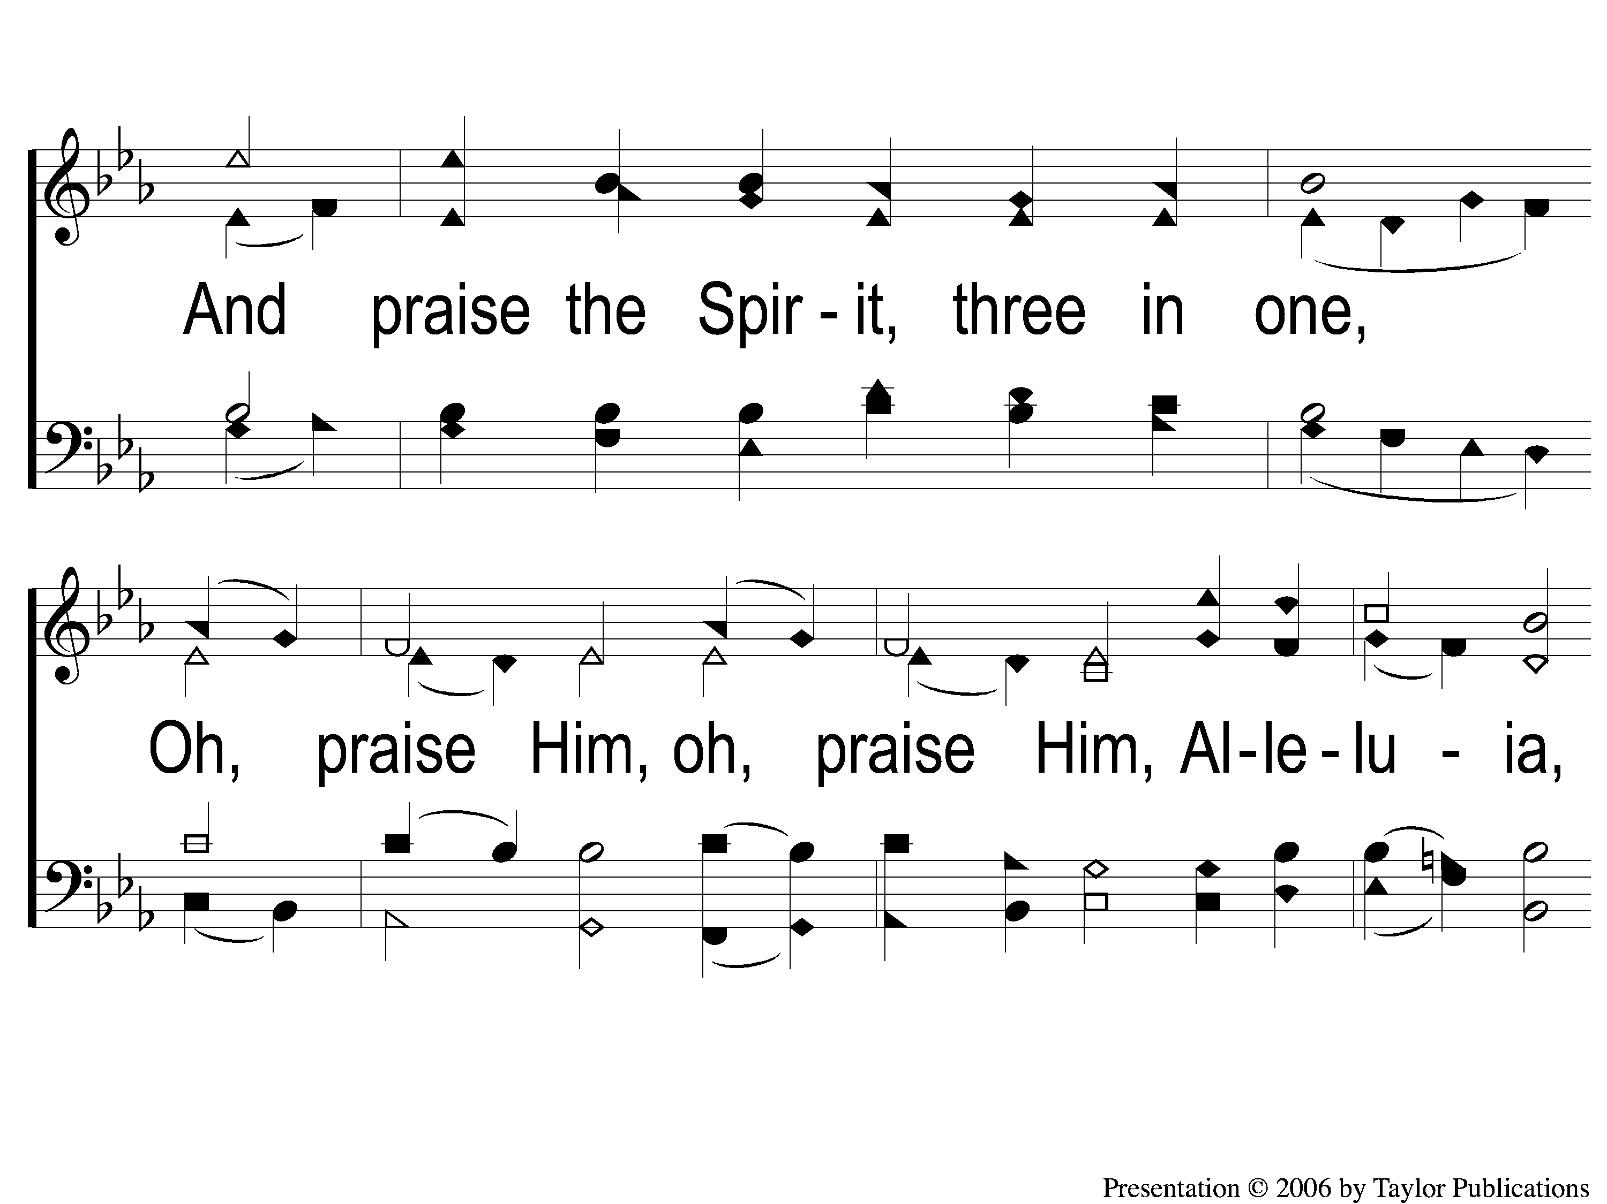
4-3 All Creatures of Our God and King
All Creatures Of Our God and King
6

Slide 16
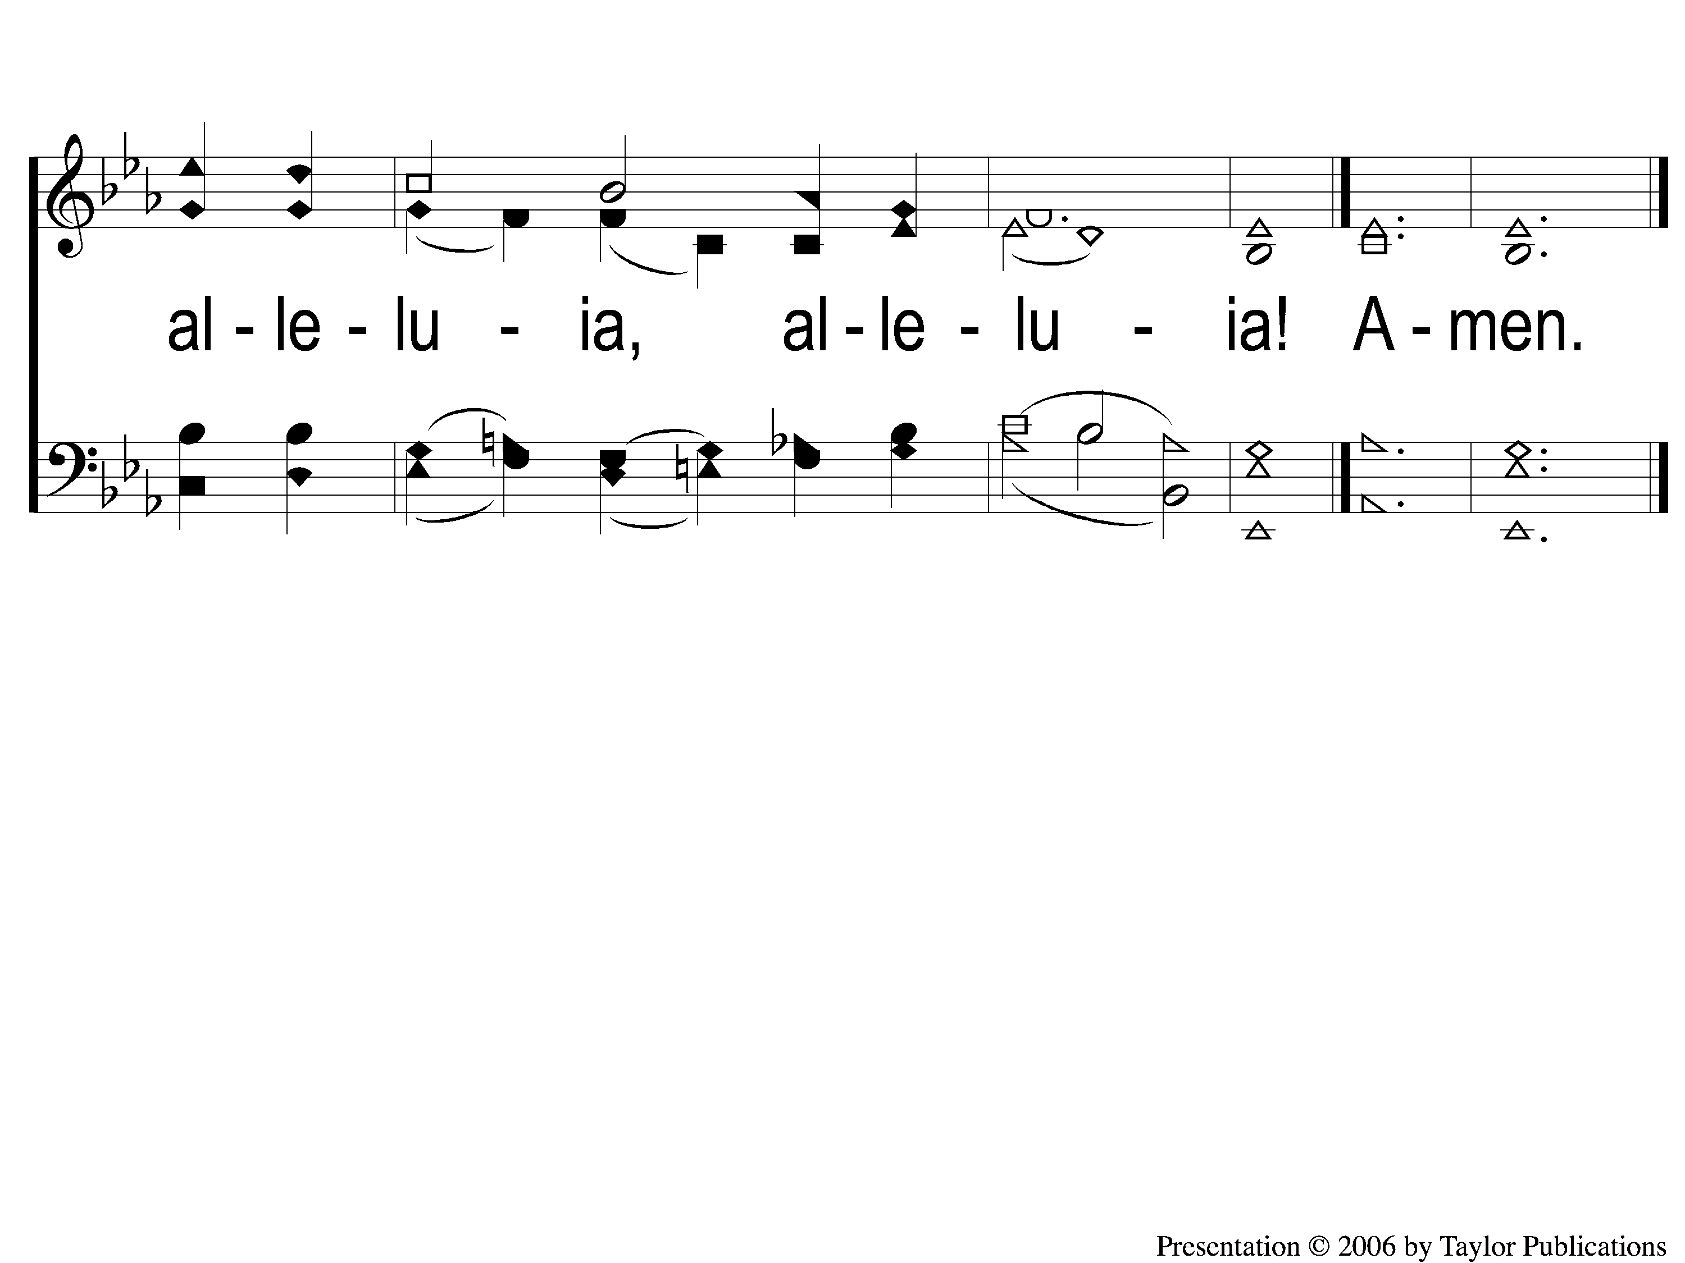
4-4 All Creatures of Our God and King
All Creatures Of Our God and King
6

